Slide 1
Rodents

Slide 2
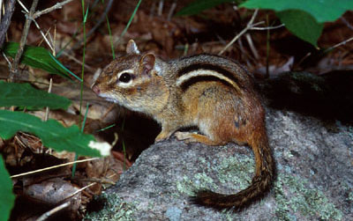
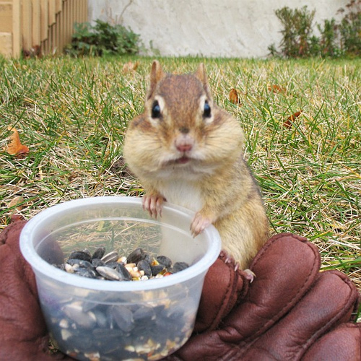
Eastern Chipmunk
Description: 8 – 10” long, reddish-brown with 5 dark stripes and a slightly flattened tail.
Adaptations:
Has internal cheek pouches that it uses to collect nuts and seeds.
Carries seeds and nuts into the burrow system to cache them for winter use.
Chipmunks are omnivores and will eat insects, insect larva, earthworms, salamanders, snakes, frogs, bird’s eggs, and young mice & birds in addition to seeds, nuts, fruits, buds and mushrooms.
Have three distinct calls to warn of alarm and to defend their territory.

Slide 3
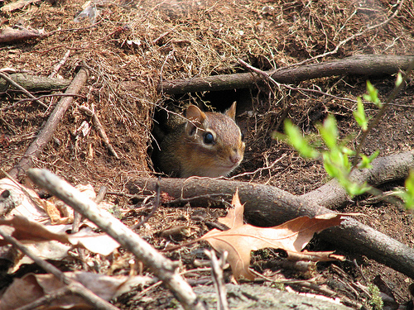
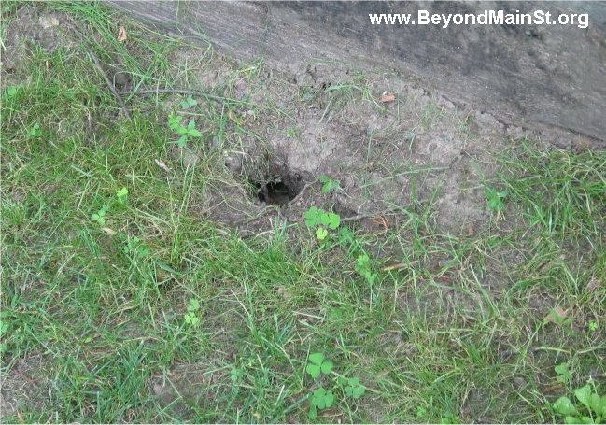

Burrows:
2” entrance hole with no signs of excavation. Often hidden by a rock, stump, log, wall, or fence post.
Burrows go straight down for several inches then level off. They can be up to 30’ long. They include storage and nest cavities as deep as 3’ below ground.
Chipmunks will enter the burrow in October or November and plug the entrances to prevent intruders and stabilize temperature.
They store food in the nest chamber and will often nest right on top of the food.
Chipmunks go into a torpid state (winter sleep) Respiration slows from 60bpm to 20bpm. Body temperature drops from 100º to 45ºF.
They will wake on occasions to relieve themselves of urine and feces and to feed on their cache.
They will emerge in the Spring.

Slide 4
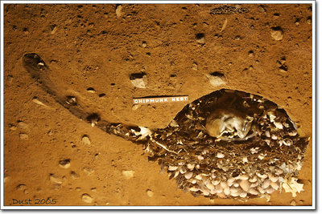
Chipmunk sleeping on top of one of his food caches.

Slide 5
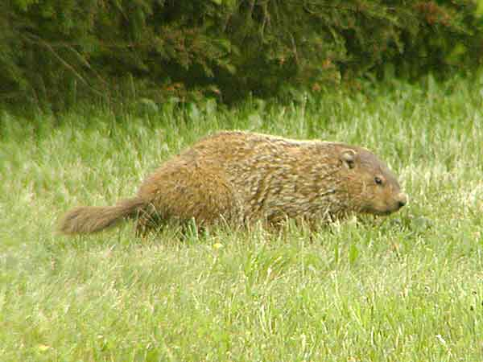
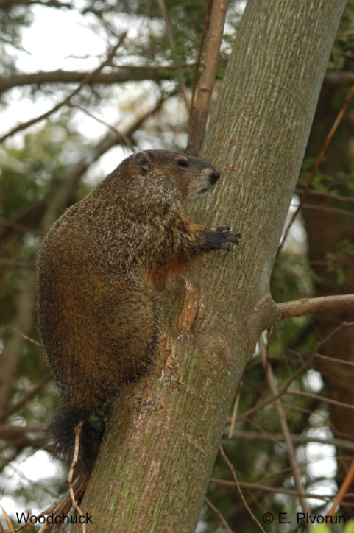
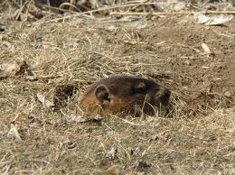
Woodchuck
Also called Groundhog, marmot, and whistle pig.
Description: 20 – 26” long, grizzled brown coloration, weighing up to 15 pounds. Sensory organs are located on top of the head (like an aquatic animal). Has white incisors, not orange or yellow.
Adaptations:
Largest members of the squirrel family. They can climb trees and descend head first. They will climb to escape danger and to feed on fruits and leaves.
Can run up to 10mph for short distances.
Do not need to drink from streams or ponds. They get the water they need from plants or after rainfall.
Will stand upright on the mound of soil at the burrow entrance to “look out” for danger.
Can whistle, grunt, and chatter their teeth.
They will be aggressive if you come between them and the entrance to their burrow.

Slide 6
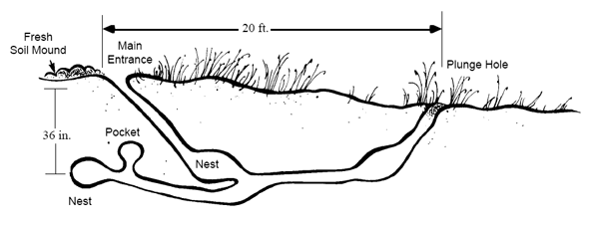
Burrows:
Groundhogs usually have two burrow systems. One for summer use and one for winter use. The winter burrow is typically located in a wooded area.
Groundhogs are great engineers. They rarely have flooding or cave-ins.
Burrows are elaborate and contain side tunnels and “drop hole” entrances as well as the main entrance with a mound of soil.
In the fall, groundhogs build up body fat (as much as 1/3 of their body weight) to survive the winter.
Woodchucks enter the burrow in October and plug the entrances to maintain a burrow temperature of 56ºF and to keep out intruders.
They are true hibernators. They will wake occasionally to use the latrine and then go back into the hibernation state.
They emerge from hibernation in late February or March.

Slide 7
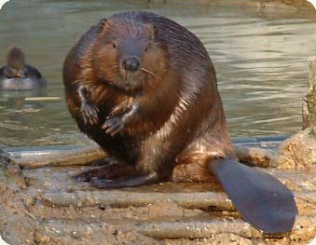
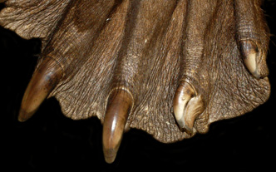
Beaver
Description: Largest N. American rodent!
32 – 48” long, weighing up to 60 pounds. Flat, scaly tail up to 20” long.
Adaptations:
Two part coat: wooly underfur with
longer water-proof guard hairs.
Flat tail used as a rudder when swimming, as a support (like a stool) when on land, to communicate (slap the tail on the surface of the water), as a fat storage organ, and to help regulate body temperature. It is not used to aid in construction.
Webbed feet allow them to swim 1-3 mph. One toe on the
hind foot has a double claw that is used for grooming purposes.
They can stay submerged for up to 15 minutes.
They have a valvular mouth with lips that close behind their incisors so they can use their teeth while under water.

Slide 8
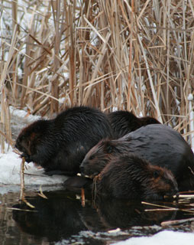
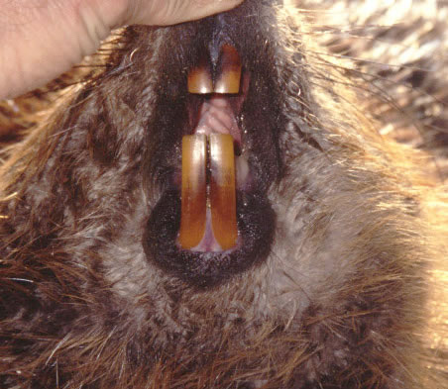
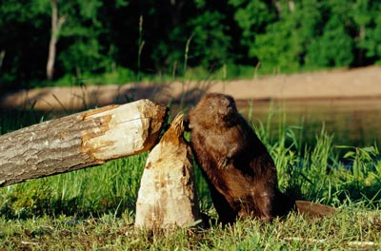
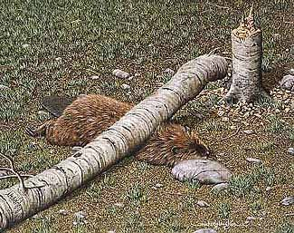
Beavers are gregarious herbivores that live in colonies.
- Beavers use their ever-growing incisors to cut trees which they use to create dams and lodges and for food.
- Beavers cannot control which way the tree will fall. Sometimes trees get caught up on other trees. And yes, sometimes the beaver is killed by the falling tree. Their top running speed is only as fast as a walking human.
- When the winter food supply in the area is depleted the beavers will move on to a new area.

Slide 9
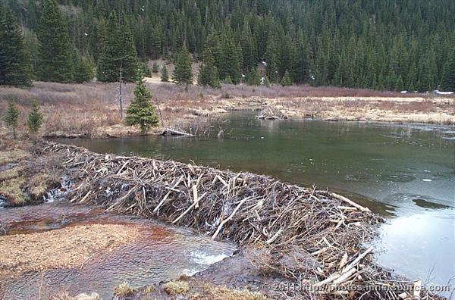
Structures:
When beavers find a suitable area, they will begin to cut trees to construct a dam. Dams are made using branches, mud, and rocks. Dams are built up and out to back the water up and create a pond. Dams have been found that are up to 8’high and thousands of feet long. The dam must be maintained daily.

Slide 10
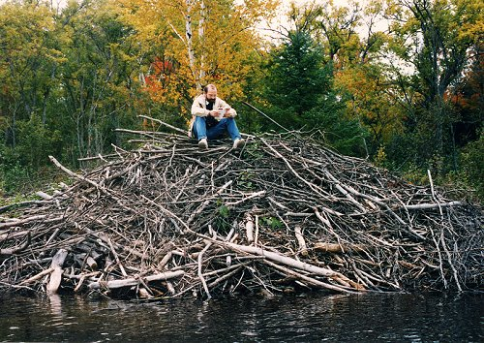
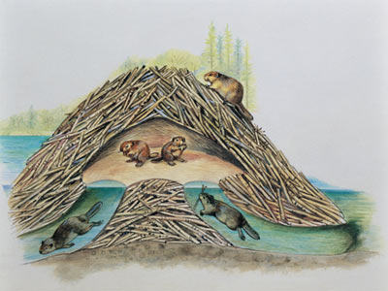
Structures cont.:
Once a pond has been created, the beavers will begin lodge construction. Lodges are the living quarters for a beaver family. One family per lodge. There may be more than one lodge in the beaver pond. Lodges are dome-shaped islands of sticks and logs plastered with mud. They have underwater entrances but living quarters are above the water level. The living den is about 5’ high. Lodges can get very large. Up to 30’ diameter and 8’ above the pond surface. They are very strong. Even bear proof.

Slide 11
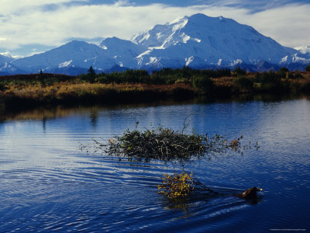
Beavers stay active in the winter. To survive when the pond surface freezes over, beavers cache branches below the surface. When they need to eat they swim out of the lodge, pick a branch from the cache, and bring it back into the lodge to eat. The picture to the right shows a cache that has been built up so high that it can be seen above the surface of the pond.

Slide 12
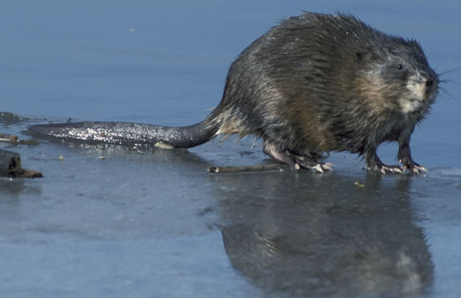
Muskrat
Description: 22-25” long, “musk” because of the scent gland between the thighs “rat” from the nearly hairless scaly tail.
Adaptations:
The tail is slightly flattened to act as a rudder when swimming. It is used as a prop when the muskrat stands on it’s hind legs.
They have webbed feet and can stay submerged for up to 15 minutes.
Importance:
Muskrats are the most abundant furbearing mammal in North America.
20,000,000 harvested annually in the U.S.
200,000 per year harvested in Pa.

Slide 13
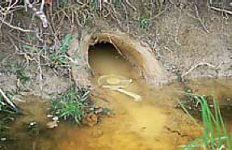
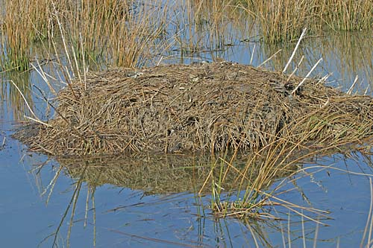
Structures:
Muskrats build lodges similar to beaver lodges but made with vegetation such as grasses, reeds, stalks, roots, and stems instead of branches. They are usually located in water that is under 2’ deep.
Lodges have been found that are as large as 10’ across and up to 4’ above the water surface. Some lodges have 2 chambers with 2 families living in them.
Some muskrats dig burrows in stream banks instead of creating lodges.

Slide 14
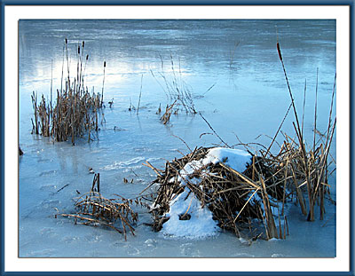
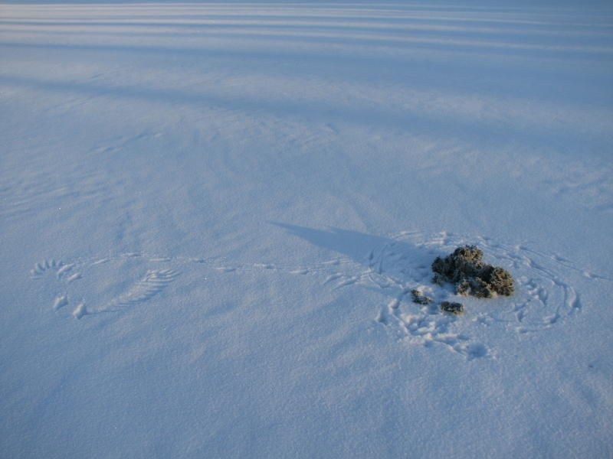
Muskrats sometimes construct smaller feeding huts near the main lodge. There may be several of these in the area.
Muskrats are omnivores who will eat small amounts of crayfish, insects, snails, fish, frogs and carrion.
To maintain access to the surface of the pond during winter, muskrats create “push ups”. These are areas where the push vegetation up through the ice as it is beginning to form. The ice freezes around the “push up”. When the muskrat needs to gain access to the surface all he needs to do is remove the plug of vegetation.
Feeding hut
“Push up” in ice.

