Slide 1
MARY ROWLANDSON
What happens?

Slide 2
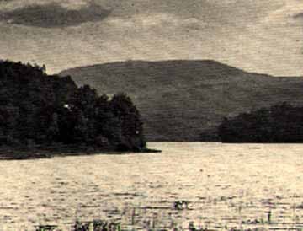
MOUNT WACHUSETT
Mary eventually was taken by the Native Americans to Mount Wachusett where the negotiations for her release began.

Slide 3
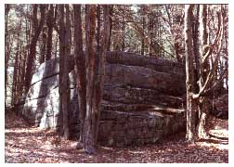
Redemption Rock
On May 2, 1676, Mary Rowlandson was exchanged at Redemption Rock for a ransom for 20 English Pounds.

Slide 4
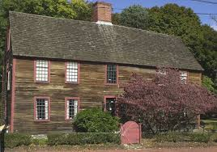
Mary’s Son?
She negotiated the ransom for her son after her release in the town of Portsmouth.

