Slide 1
Essential Question:
  What factors encouraged the European Age of Exploration?

Slide 2
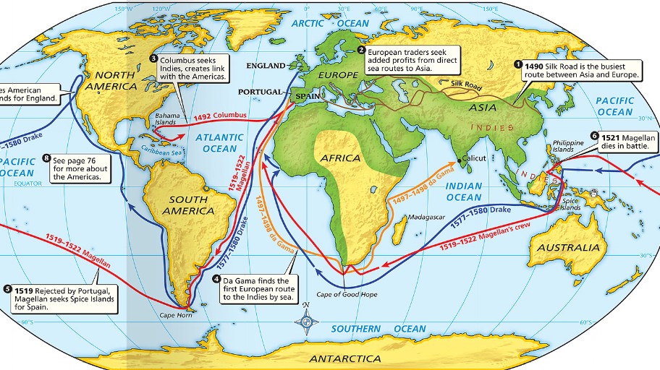
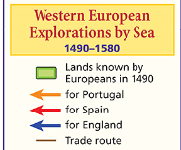
From the 1400s to the 1700s, Europe experienced an “Age of Exploration”
The Renaissance encouraged curiosity & a desire for trade
Motivations:
Why did Europeans want to explore?
As a result of exploration, European nations grew powerful & spread their influence throughout the world
Notes:
A period beginning in the early 1400s and ending in the late 1700s in which European explorers and merchants discovered areas of the world yet unseen by Western Europe. These expeditions led to the discovery of new lands, new markets, and new technology
By the early 1400s, Europeans were ready to venture beyond their borders. As Chapter 17 explained, the Renaissance encouraged,
among other things, a new spirit of adventure and curiosity. This spirit of adventure, along with several other important reasons, prompted Europeans to explore the world around them. This chapter and the next one describe how these explorations began a long process that would bring together the peoples of many different lands and permanently change the world.
For “God, Glory, and Gold”
Europeans had not been completely isolated from the rest of the world before the 1400s. Beginning around 1100, European crusaders battled Muslims for control of the Holy Lands in Southwest Asia. In 1275, the Italian trader Marco Polo reached the court of Kublai Khan in China. For the most part, however, Europeans had neither the interest nor the ability to explore foreign lands. That changed by the early 1400s. The desire to grow rich and to spread Christianity, coupled with advances in sailing technology, spurred an age of European exploration.

Slide 3
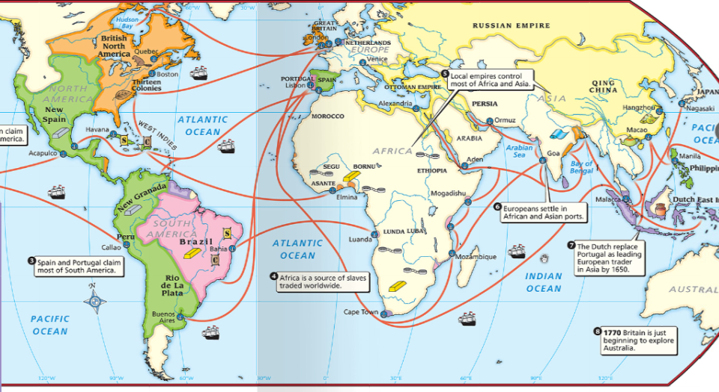
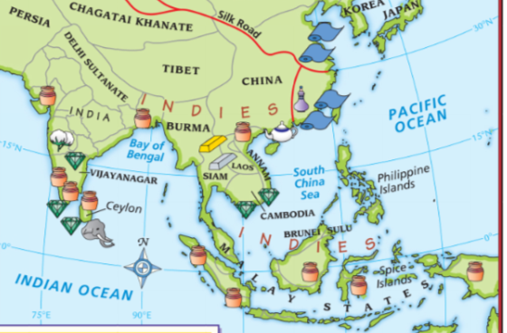
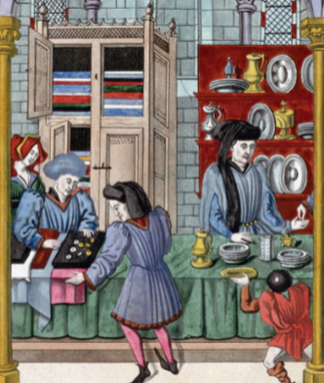
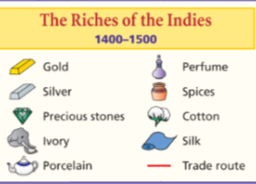
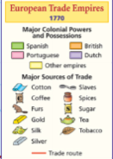
Gold (Money)
Merchants began looking for quick, direct trade routes to Asia to avoid Muslim & Italian merchants & increase profits
A desire for new sources of wealth was the main reason for European exploration
The Crusades & Renaissance stimulated European desires for exotic Asian luxury goods
Notes:
The desire for new sources of wealth was the main reason for European exploration. Through overseas exploration, merchants and traders hoped ultimately to benefit from what had become a profitable business in Europe: the trade of spices and other luxury goods from Asia. The people of Europe had been introduced to these items during the Crusades, the wars fought between Christians and Muslims from 1096 to 1270 (see Chapter 14). After the Crusades ended, Europeans continued to demand such spices as nutmeg, ginger, cinnamon, and pepper, all of which added flavor to the bland foods of Europe. Because demand for these goods was greater than the supply, merchants could charge high prices and thus make great profits. The Muslims and the Italians controlled the trade of goods from East to West. Muslims sold Asian goods to Italian merchants, who controlled trade across the land routes of the Mediterranean region. The Italian merchants resold the items at increased prices to merchants throughout Europe. Other European traders did not like this arrangement. Paying such high prices to the Italians severely cut into their own profits. By the 1400s, European merchants—as well as the new monarchs of England, Spain, Portugal,
and France—sought to bypass the Italian merchants. This meant finding a sea route directly to Asia.

Slide 4
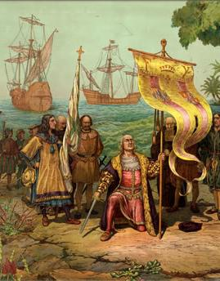
Glory
Kings who sponsored voyages of exploration gained overseas colonies, new sources of wealth for their nation, & increased power
The Renaissance inspired new possibilities for power & prestige
Exploration presented Europeans
the opportunity to rise from poverty
and gain fame, fortune, & status
Notes:
Renaissance inspired new possibilities (no one explored during the Middle Ages)
Exploration led to fame for the explorers & sponsor country (found new places & gained more lands)
Demand for new land & glory led to competition between countries

Slide 5
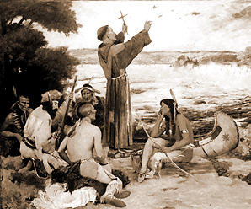
God
European Christians, especially Catholics, wanted to stop the spread of Islam &
convert non-Christians to the faith
Explorers were encouraged to spread Christianity or bring missionaries who would focus only on conversions
Notes:
During the Middle Ages & the Renaissance, Europe was very religious
Christians wanted to stop the spread of Islam & also convert “natives” they discovered to Christianity; explorers were encouraged to spread Christianity or bring missionaries who would focus only on conversions

Slide 6
The Age of Exploration
Means:
How were explorers able to sail
so far & make it back again?
Before the Renaissance, sailors did not have the technology to sail very far from Europe & return

Slide 7
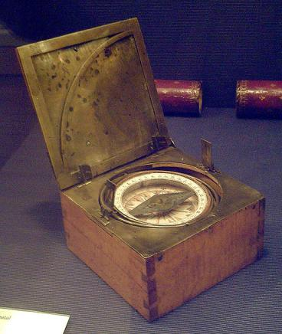
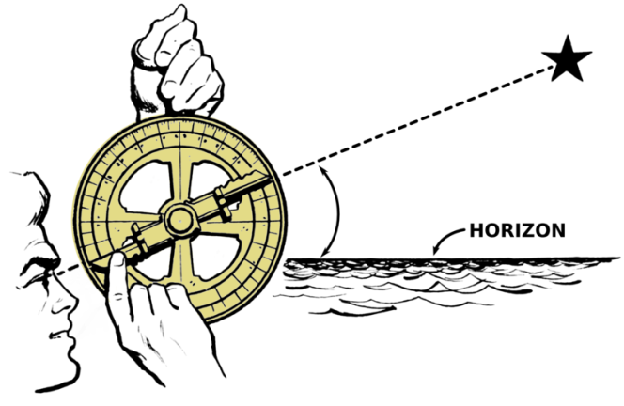
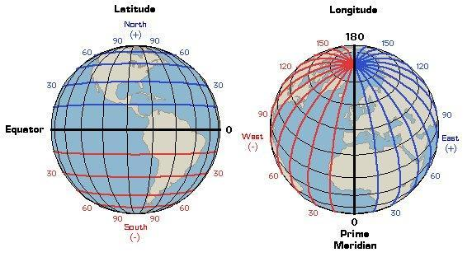
Navigation
Trade & cultural diffusion during the Renaissance introduced new navigation techniques to Europeans
Astrolabe used stars to show direction
Magnetic compass made sailing more accurate
Maps were more accurate and used longitude & latitude

Slide 8
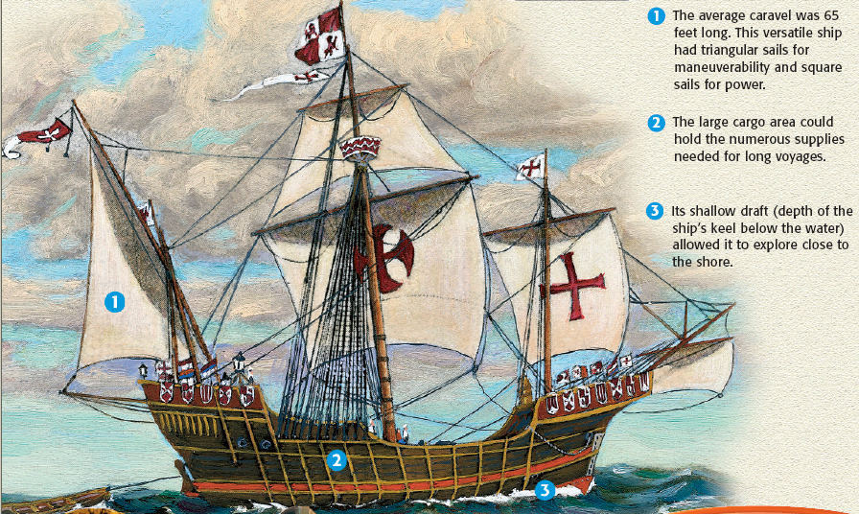
European shipbuilders built a better ship;
The caravel was a strong ship that could travel in the open seas & in shallow water
Caravels had triangular lateen sails that allowed ships to sail against the wind
A moveable rudder made the caravel more maneuverable
Cannons & rifles
gave ships protection
Notes:
While “God, glory, and gold” were the primary motives for exploration, advances in technology made the voyages of discovery possible. During the 1200s, it would have been nearly impossible for a European sea captain to cross 3,000 miles of ocean and return again. The main problem was that European ships could not sail against the wind. In the 1400s, shipbuilders designed a new vessel, the caravel. The caravel was sturdier than earlier vessels. In addition, triangular sails adopted from the Arabs allowed it to sail effectively against the wind. Europeans also improved their navigational techniques. To better determine their location at sea, sailors used the astrolabe, which the Muslims had perfected. The astrolabe was a brass circle with carefully adjusted rings marked off in degrees. Using the rings to sight the stars, a sea captain could calculate latitude, or how far north or south of the equator the ship was. Explorers were also able to more accurately track direction by using a magnetic compass, a Chinese invention.

Slide 9
The Age of Exploration
Who were the explorers, where did they go, & how did they change world history?

Slide 10
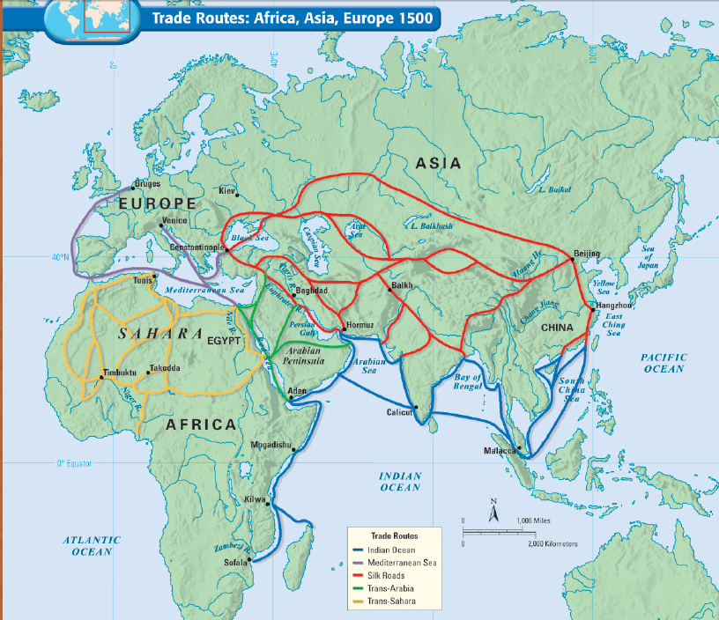
Europeans were not the first to explore the oceans in search of new trade routes
Islamic merchants explored the Indian Ocean & had dominated the Asian spice trade for centuries before European exploration
Notes:
Islamic merchants were the 1st to extensively sail in the Indian Ocean (the Spice Trade)
Chinese Admiral Zheng He & the Ming “Treasure Fleet” sailed to Africa (& maybe further)
But in the late 1400s, there is a new player: European explorers

Slide 11
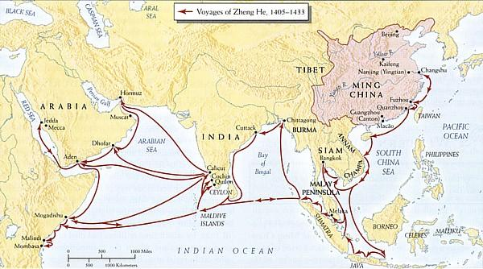
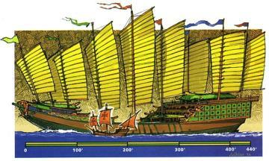
Early Exploration
From 1405 to 1433, Zheng He led the Chinese treasure fleet on
7 expeditions to SE Asia, India, & Africa during the Ming Dynasty

Slide 12
But in the late 1400s, the European sailors did what neither Muslim nor Chinese explorers could: Begin global (not regional) exploration &
create colonies to increase their wealth & power

Slide 13
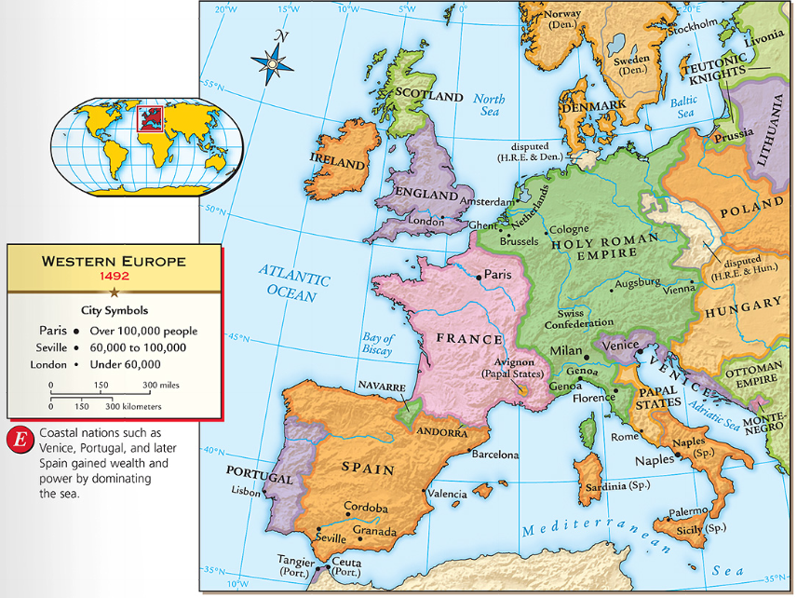
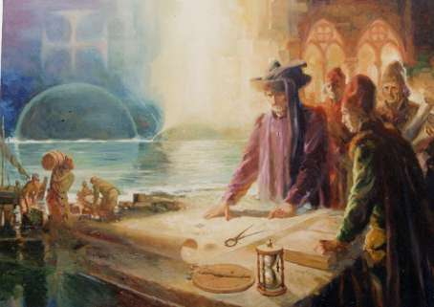
Portugal was the early leader in the
Age of Exploration
In Portugal, Prince Henry the Navigator started a school of navigation to train sailors
He brought in Europe’s best map-makers, ship-builders, & sailing instructors
He wanted to discover new territories, find a quick trade route to Asia, & expand Portugal’s power

Slide 14
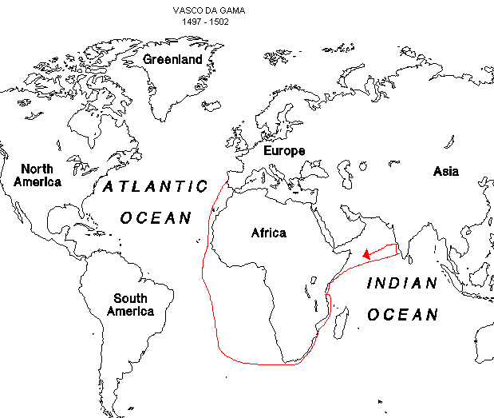
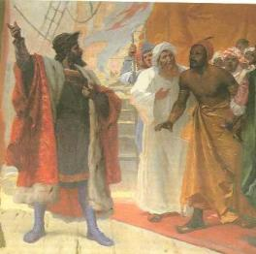
Prince Henry’s navigation school & willingness to fund voyages led the Portuguese to be the 1st to explore the west coast of Africa
Vasco da Gama was the 1st explorer to find a direct trade route to Asia by going around Africa to get to India
Portugal gained a sea route to Asia that brought them great wealth

Slide 15
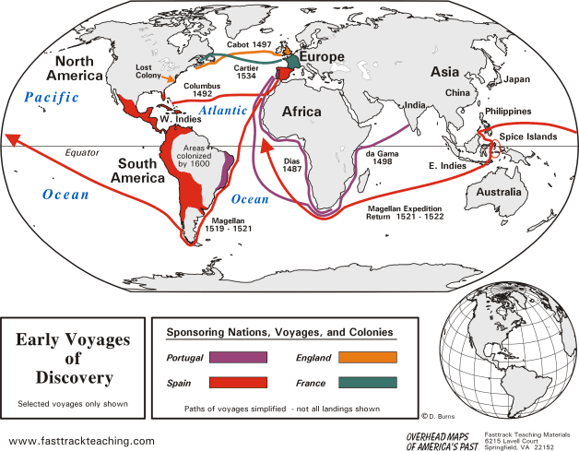
During the Age of Exploration, Portugal created colonies along the African coast, in Brazil, & the Spice Islands in Asia

Slide 16
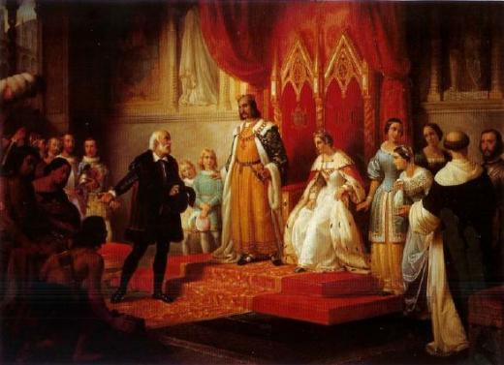
The Spanish government
saw Portugal’s wealth &
did not want to be left out
More than any other European monarch, Ferdinand & Isabella of Spain sponsored & supported overseas expeditions

Slide 17
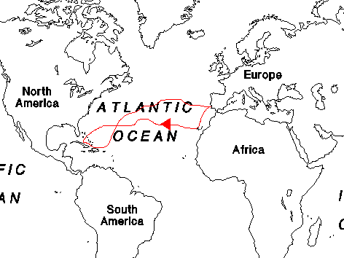
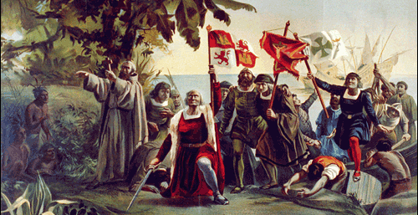
Like most educated men of the Renaissance, Columbus believed the world was round & thought he could reach Asia by sailing west
Columbus reached the Bahamas in America but thought that he had reached islands off the coast of India
He made 4 trips to “India” never knowing he was in “America”

Slide 18
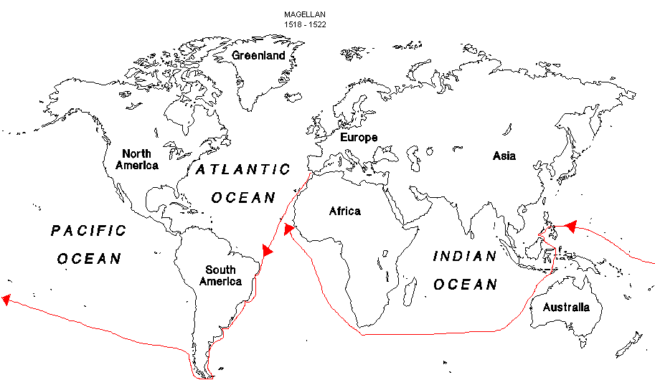
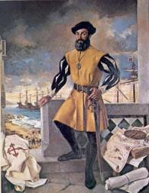
Despite the fact that Columbus never found Asia, Ferdinand Magellan still thought he could reach Asia by sailing West
Magellan became the first explorer to circumnavigate the Earth (go all the way around)

Slide 19
During the
Age of Exploration,
Spain created colonies in
North & South America

Slide 20
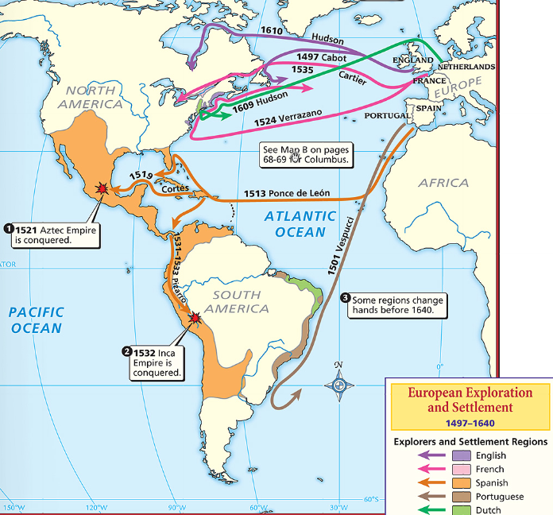
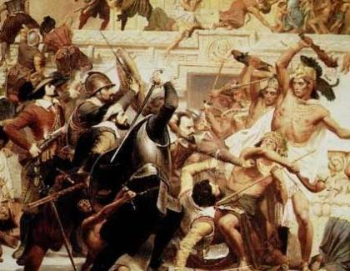
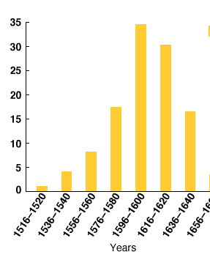

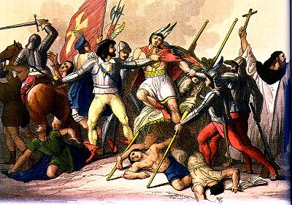
Spain sent explorers called conquistadors to the New World to find gold, claim land, & spread Christianity
Cortez conquered the Aztecs
Pizarro conquered the Inca
The influx of gold from America made Spain the most powerful country in Europe during the early years of the
Age of Exploration
Notes:
Spain sent explorers to the New World to find gold, claim land, & spread Christianity
Cortez conquered Mexico & destroyed the Aztec civilization
Pizarro conquered Peru & destroyed the Incan civilization

Slide 21
England, France, & the Netherlands became involved in overseas exploration & colonization as well

Slide 22
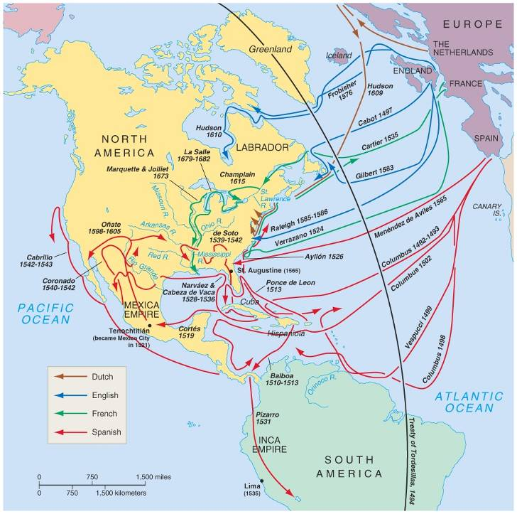
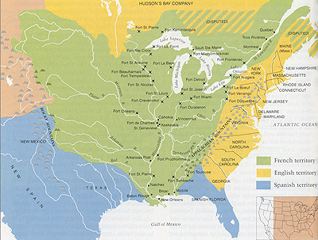
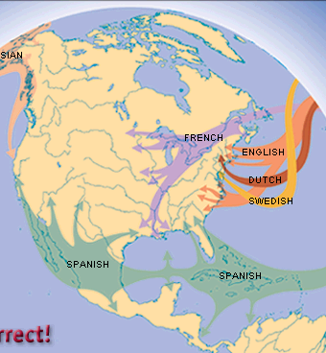
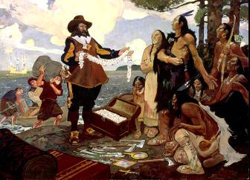

After failing to do so, Champlain founded the French colony of Quebec
The French explorer Samuel de Champlain searched Canada for a northwest passage to Asia
The French would soon carve out a large colony along the Mississippi River from Canada to New Orleans

Slide 23
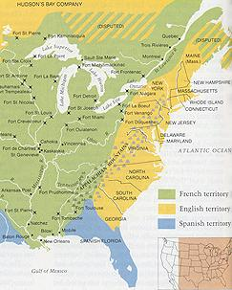
Unlike other European nations whose kings paid for colonies, the English colonies were paid for
by citizens who formed joint-stock companies
English colonies formed along the Atlantic Coast of North America by colonists motivated either by religion
or wealth

Slide 24
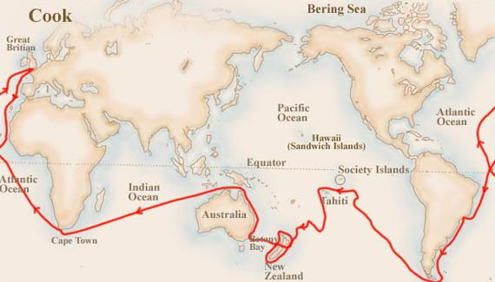
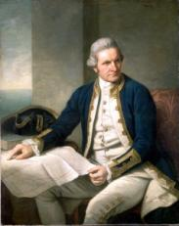
The English explorer James Cook was the first European to make contact with Australia, New Zealand, & Hawaii

Slide 25
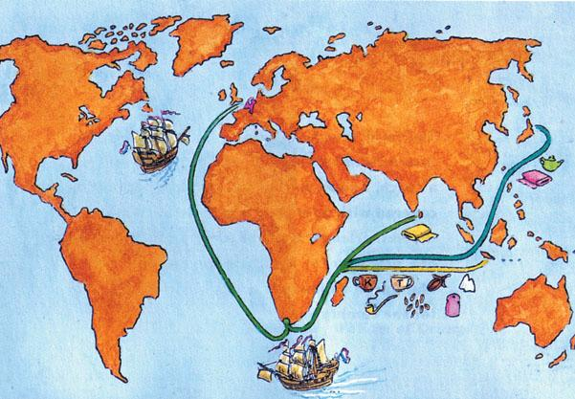
Like England, the Netherlands (the Dutch) allowed private companies to fund exploration
The Dutch had colonies in America & Africa, but the Dutch East India Company dominated trade in Asia

Slide 26
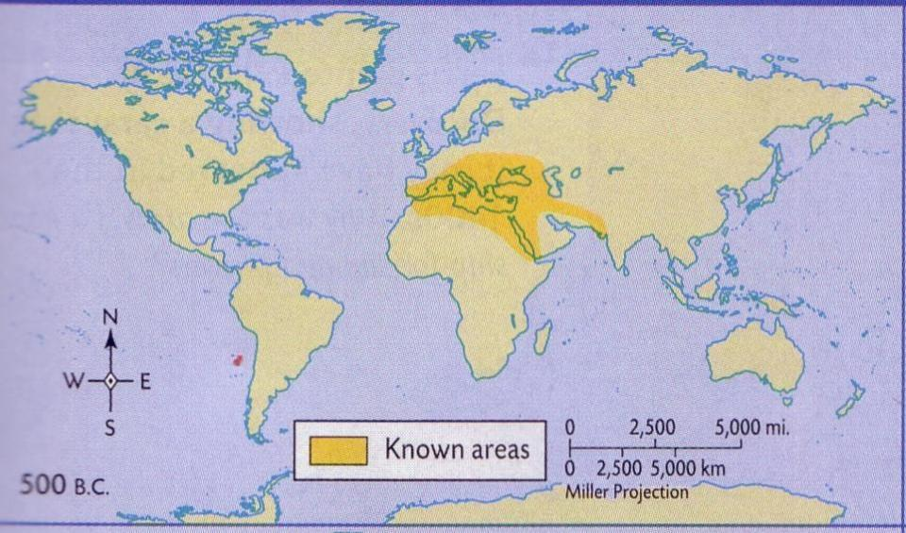
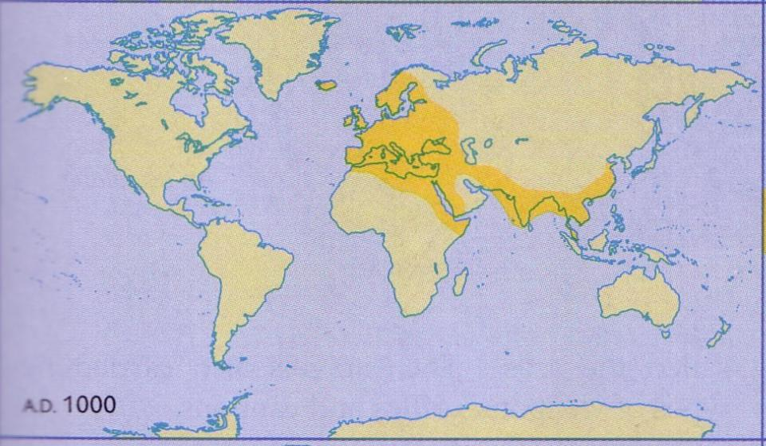
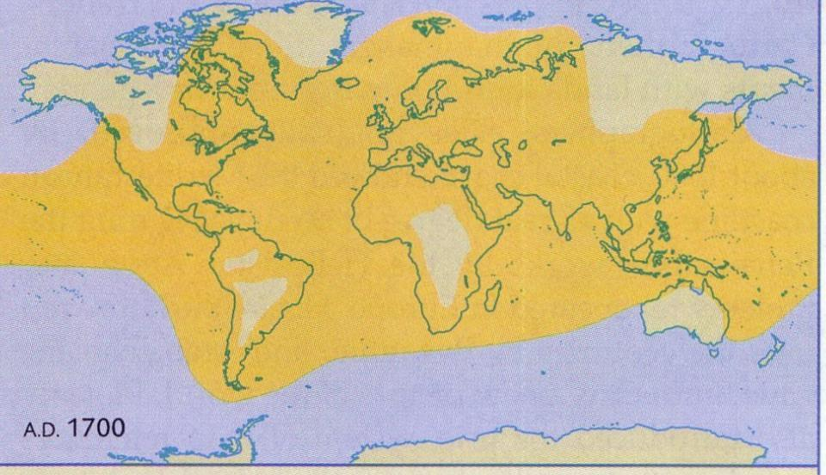
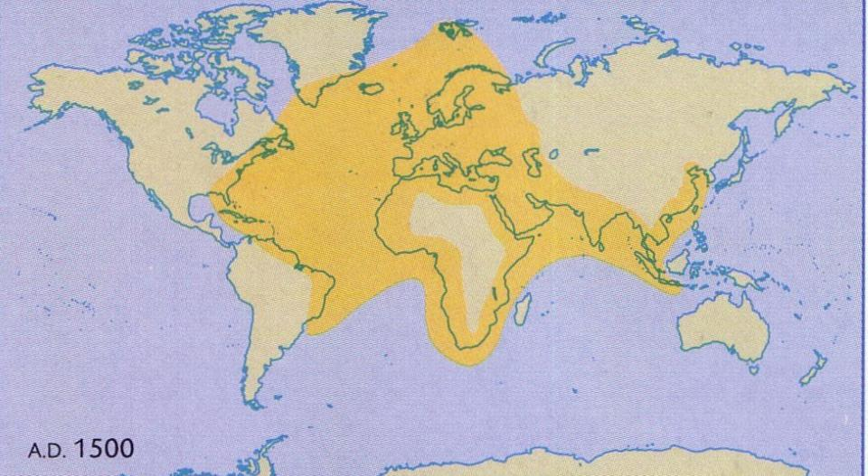
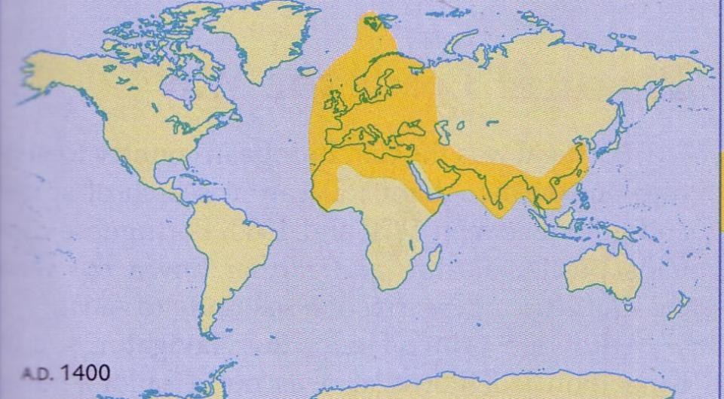
Conclusions
As a result of the Age of Exploration, European knowledge & influence of the world increased greatly

